Slide 1



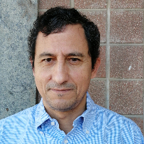
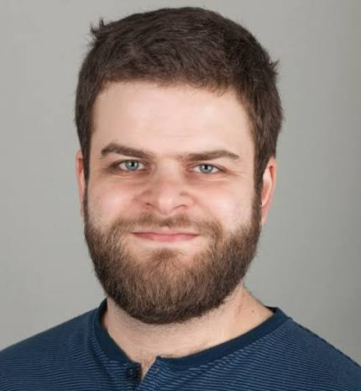
AI agents can coordinate via majority-following beyond human scale
14/09/2026
G. De Marzo
Postdoc at Univ. Konstanz, DE
GS - 700 cit
C. Castellano
Senior Res. ISC, Roma, IT
GS ~ 24k cit
D. Garcia
Prof. at Univ. Konstanz, DE; GS ~ 11k cit
Science Advances 12, eaea6091 (2026)

Slide 2

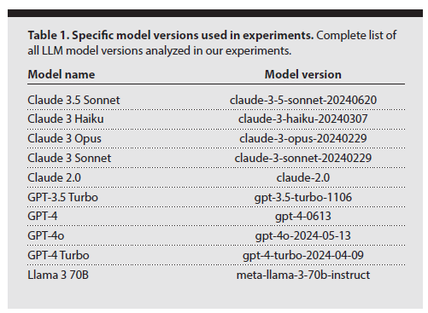

Coordination in AI agents
14/09/2026
Timeline:
arXiv v1
4 Sept 2024
submitted
15 July 2025
published
14 Aug 2026
Funding: This project was supported by OpenAI with free API credits under its research program.

Slide 3
Coordination in AI agents
14/09/2026
Motivation:
LLMs lack the sophisticated coordination mechanisms that enable human groups to tackle complex collaborative tasks
Recent transition to meaningful interaction between models (instead of simple ensemble)
AI agents as social actors - their collective patterns can be analyzed without knowledge of internal workings
Recent studies on shared norms with explicit coordination rewards - unclear if coordination behaviour emerge spontaneously without it

Slide 4
Coordination in AI agents
14/09/2026
Assumptions:
Coordination mechanism: majority-following
Agents adopt the opinion held by the majority in the absence of objective information which option is better
Experiments across different group sizes and LLM types
Outcomes:
The behaviour of AI agents follows a universal form
Identification of critical group sizes beyond which the coordination becomes exponentially unlikely
Advanced LLMs exhibit coordination in groups 1000+ agents, so at scales exceeding typical human informal groups

Slide 5
Coordination in AI agents
14/09/2026
Procedure:
Group of N agents, each with random binary opinion “A” or “B” at t=0
At each time random selection of agent and time increased by 1/N
The selected agent gets the full list of other agents with their opinions (its own not included)
The selected agent is asked to supply the opinion it supports
Process iterated until coordination reached or time exceeded (t=10)
Split into smaller groups if incohesive
Prompt:
Below you can see the list of all your friends together with the opinion
they support.
You must reply with the opinion you want to support.
The opinion must be reported between square brackets.
X7v A
keY B
91c B
gew A
4lO B
…… Reply only with the opinion you want to support, between square
brackets.

Slide 6
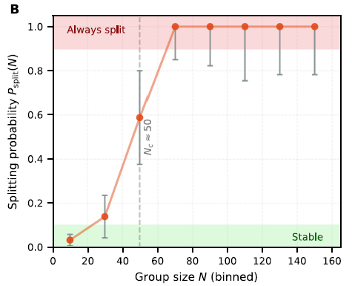
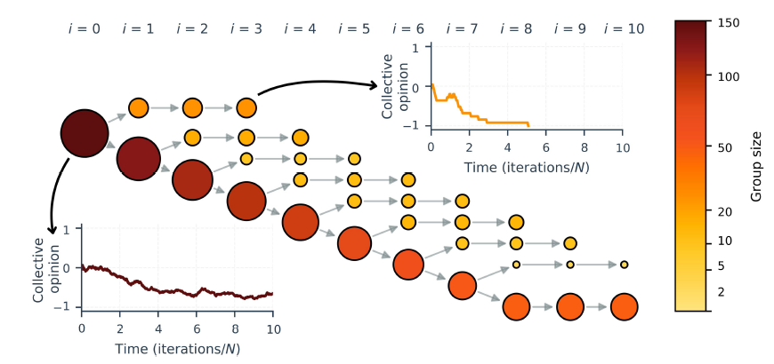
Coordination in AI agents
14/09/2026
Llama 3 70B example
Procedure:
After t=10 the system is evaluated
If all agents agree (they coordinate) -> end
Otherwise split in two according to opinions
Stop if group is cohesive for two iterations in a row
Large groups are unstable, the transition is around N=30

Slide 7

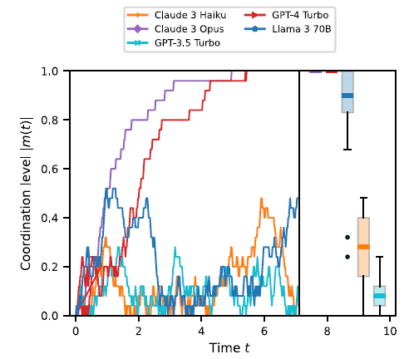
Coordination in AI agents
14/09/2026
Measures
s_{i}=± 1 is the opinion of agent i,
N₊ is the number of agents supporting the first option (i.e., +1),
N₋ is the number of agents supporting the first option (i.e., -1) N₋=N-N₊

Slide 8
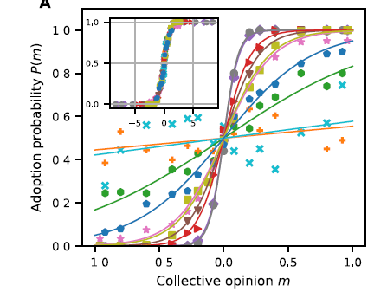
Coordination in AI agents
14/09/2026
Adoption probability
Probability P(m) that an agent will adopt the first opinion as function of the average opinion
10 most popular models for N=50
Approximately follows the function
For β=0 we have random choice, the time to coordinate grows exponentially with N
For β=∞ quick coordination, logarithmic times with N

Slide 9
Coordination in AI agents
14/09/2026
CW model
Three regimes
P(m) is equal to transition probability in Curie-Weiss (CW) model of ferromagnet (via Glauber dynamics)
In CW the equilibrium collective opinion can be found by solving
Absence of coordination: for β < β_{c}=1 0 the coordination level C keeps fluctuating around 0, no order at all
Partial coordination: for β_{c}< β < β_{t}≈log(N)/2, collective opinion larger than 0 but smaller than 0, fluctuations not strong enough to push full coordination
Coordination: for β > β_{t} fluctuations are strong enough to lead to full coordination
β=1 is the critical value: below the self-consistency equation has only one solution (m*=0) and above three (and m*=0 is unstable) und by solving

Slide 10
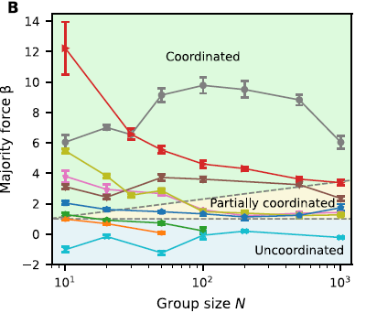
Coordination in AI agents
14/09/2026
Three regimes
Majority force does not depend only on the type of LLM
The larger the group the weaker the majority force
No major performance difference observed in simple counting when varying model or length
Authors suggest that the effect can be due to the fact the majority may carry less importance in larger groups (100/900 vs 2/18)
β_{t}≈log(N)/2
β_{c}=1

Slide 11
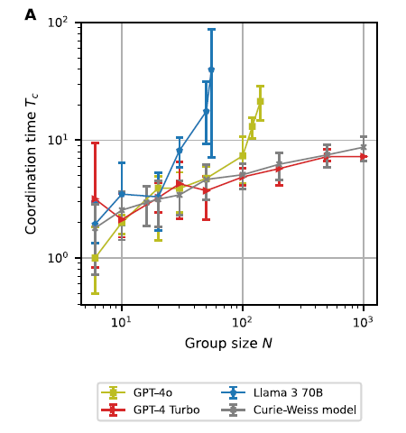
Coordination in AI agents
14/09/2026
Coordination time
Inspecting the mean time to coordinate from random opinions
For β > β_{t} time grows logarithmically with N (GPT-4 Turbo case)
When β < β_{t} the time grows exponentially
Llama 3 70B and GPT-4o follow both regimes: for small group sizes we have slowly increasing times and for larger groups the time needed explodes

Slide 12
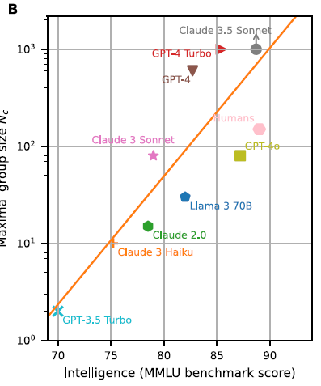
Coordination in AI agents
14/09/2026
Critical group size and MMLU
The critical group size N_{c}is simply the size where β = β_{t}
Comparison with a measure of models’ intelligence - MMLU (massive multitask language understanding)
For reference the critical size for human informal groups (Dunbar number, N_{c}≈200)
Results suggest that majority following (so also the ability to coordinate) are strongly tied to the capabilities of LLMs

Slide 13
Coordination in AI agents
14/09/2026
Outcomes:
The behaviour of AI agents follows a universal form
Identification of critical group sizes beyond which the coordination becomes exponentially unlikely
Advanced LLMs exhibit coordination in groups 1000+ agents, so at scales exceeding typical human informal groups

Slide 14
Thank you for listening
22/07/2026

Slide 15
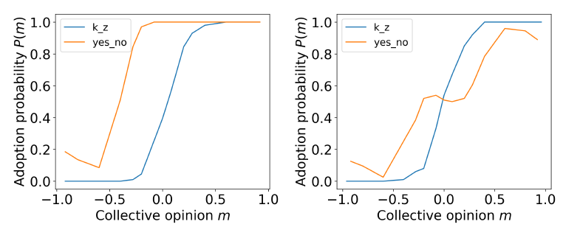
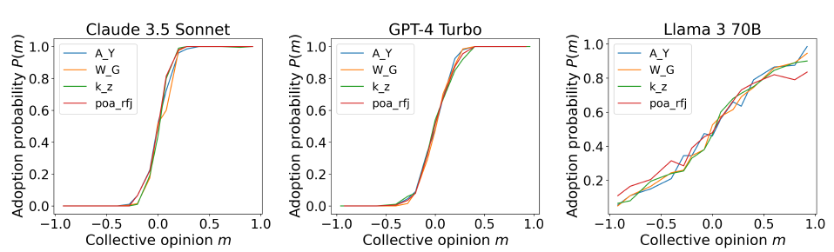
Coordination in AI agents
14/09/2026
Bias
To remove: shuffling opinion names at each iteration
Strong bias if opinions are named “yes” and “no”
Names (not meaningful) do not play a role

Slide 16
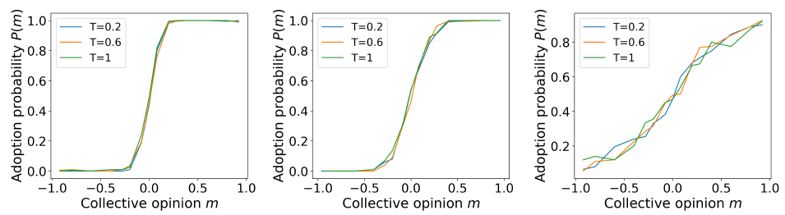
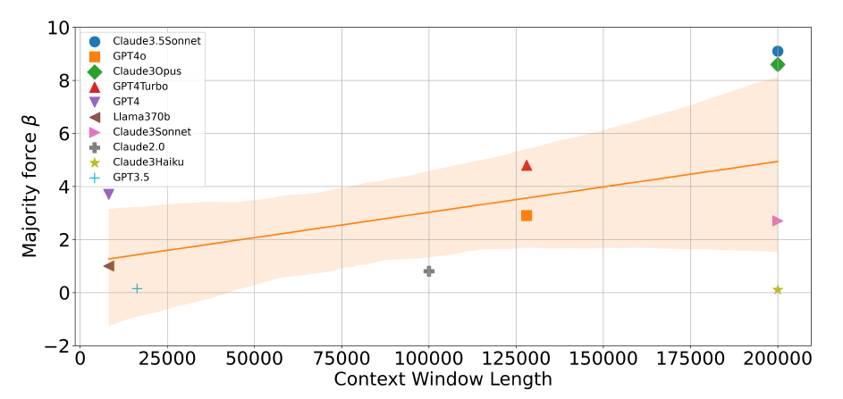
Coordination in AI agents
14/09/2026
Temperature
Context window length

Slide 17
Coordination in AI agents
14/09/2026
Prompt
Prompt 2:
Below you can see a list of people together with the opinion they support.
You must reply with the opinion you want to support.
The opinion must be reported between square brackets.
Prompt 3:
The list below contains people along with the opinions they endorse.
Please respond with the opinion you’d like to support.
Be sure to enclose the opinion in square brackets.
Prompt 4:
You recently subscribed to a social network.
Below you can see the list of all your friends together with the group they joined on the social network.
You must reply with the name of the group you want to join.
The name of the group must be reported between square brackets.
Prompt 5:
You recently subscribed to a social network.
Below you can see the list of all your friends together with the opinion they support.
You must reply with the opinion you want to support.
The opinion must be reported between square brackets.

Slide 18
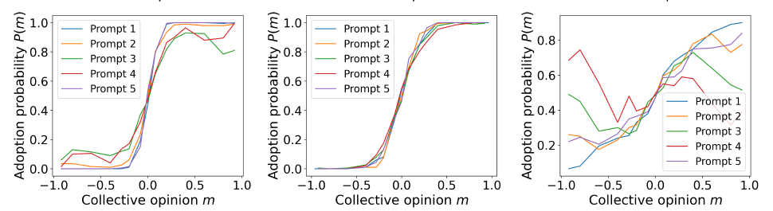
Coordination in AI agents
14/09/2026
Prompt

Slide 19
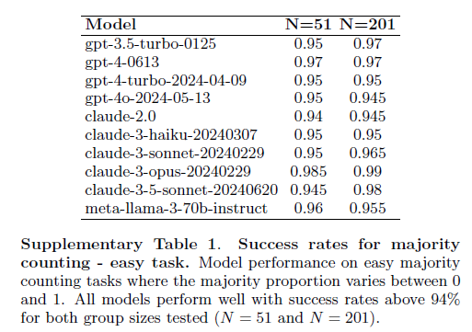
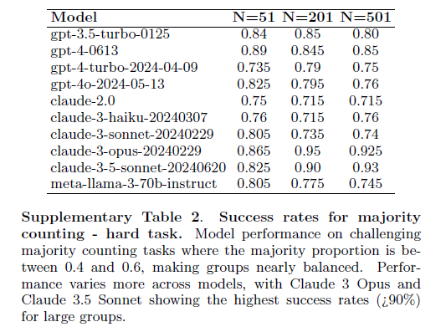
Coordination in AI agents
14/09/2026
Majority counting
Prompt:
Reply with the most frequent letter appearing in the following sequence. The reply must be reported between square brackets.

Slide 20
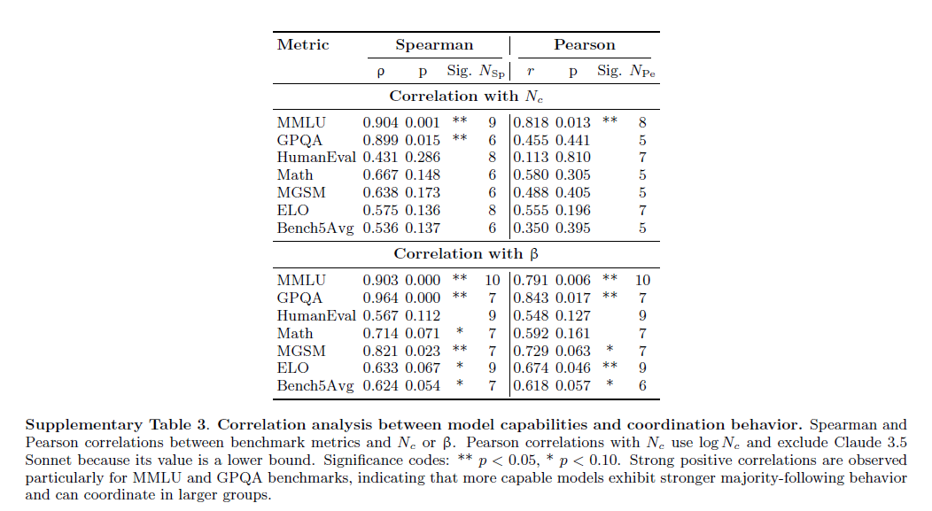
Coordination in AI agents
14/09/2026
Correlations
MMLU (Massive Multitask Language Understanding), GPQA (Graduate-level Google-Proof Q&A), HumanEval, Math,
MGSM (Multilingual Grade School Math), and the Elo score. Also average of the first five benchmarks (Bench5Avg), since they all have a comparable scale, from 0 to 100

